Slide 1

Leading High-Performing Organisations
Assignment 2 Part B
Stratum Drinks Wholesalers Ltd

Slide 2
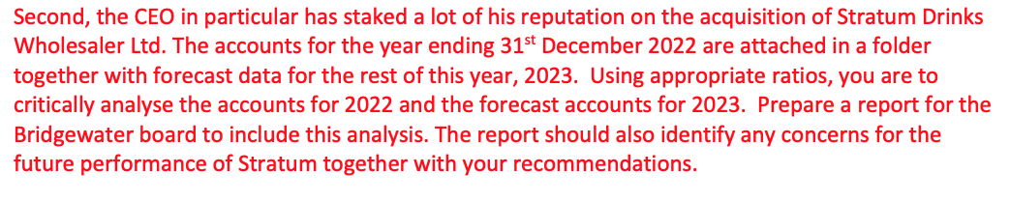

Slide 3
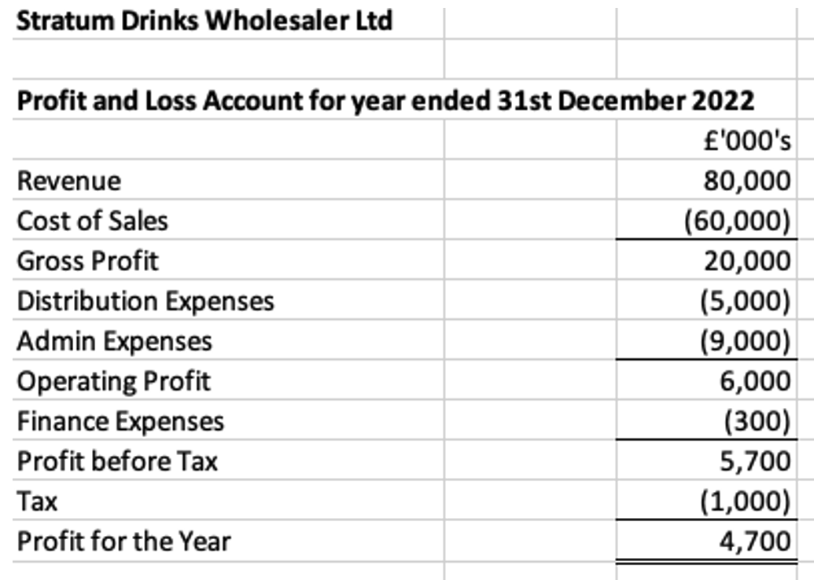

Slide 4
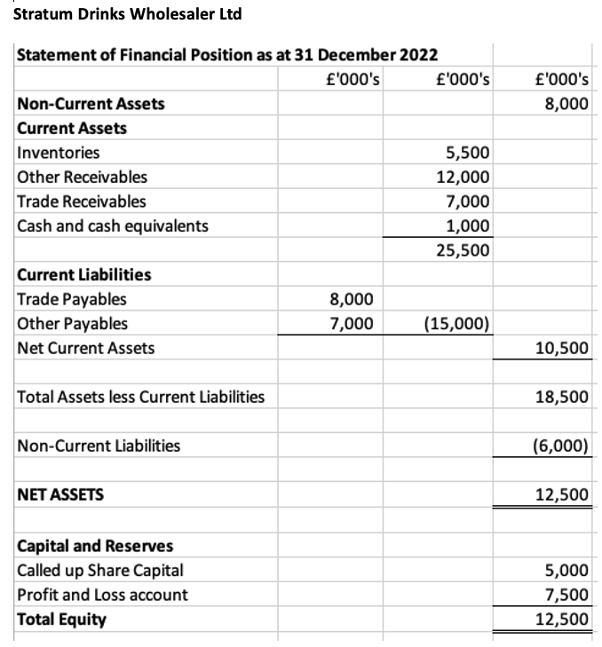

Slide 5
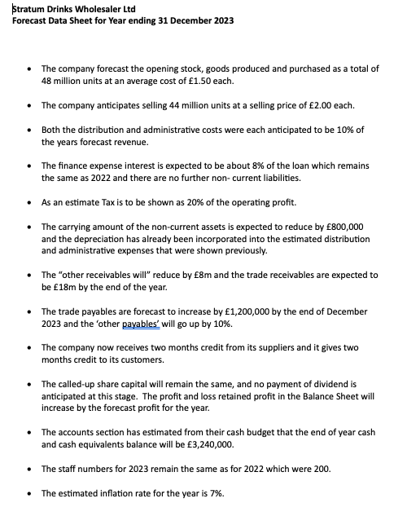

Slide 6
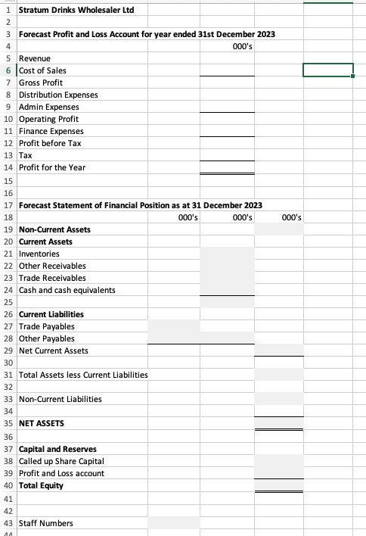

Slide 7
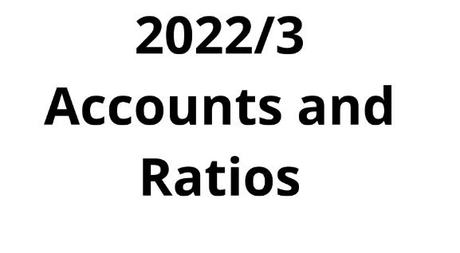

Slide 8
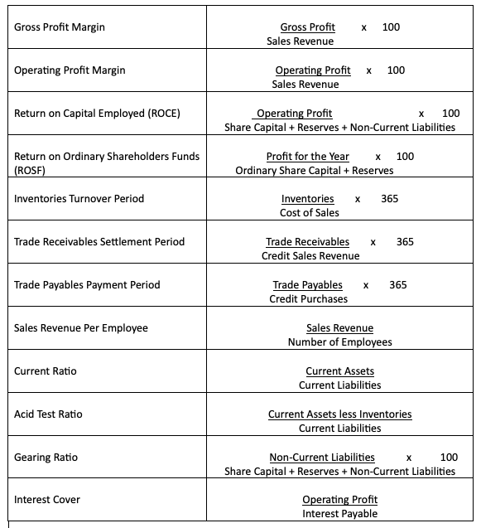
Phase 1- Calculate Ratios for 2022

Slide 9
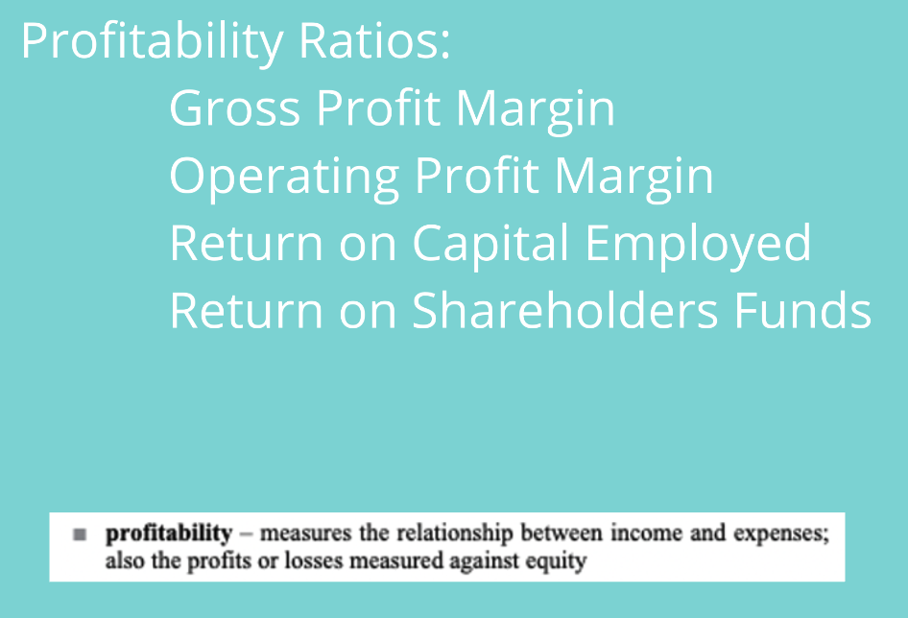

Slide 10
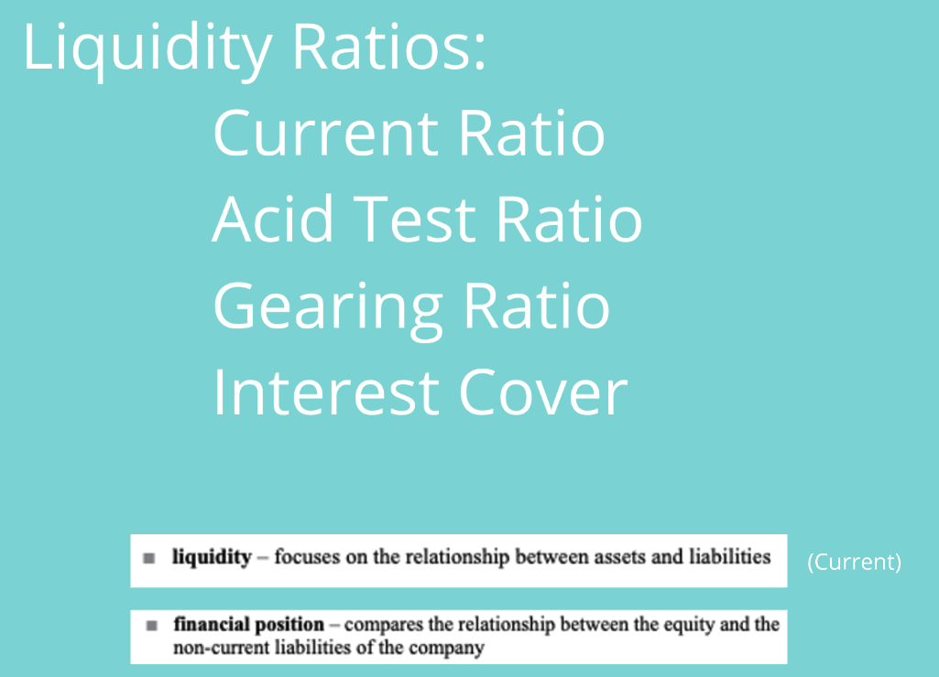

Slide 11
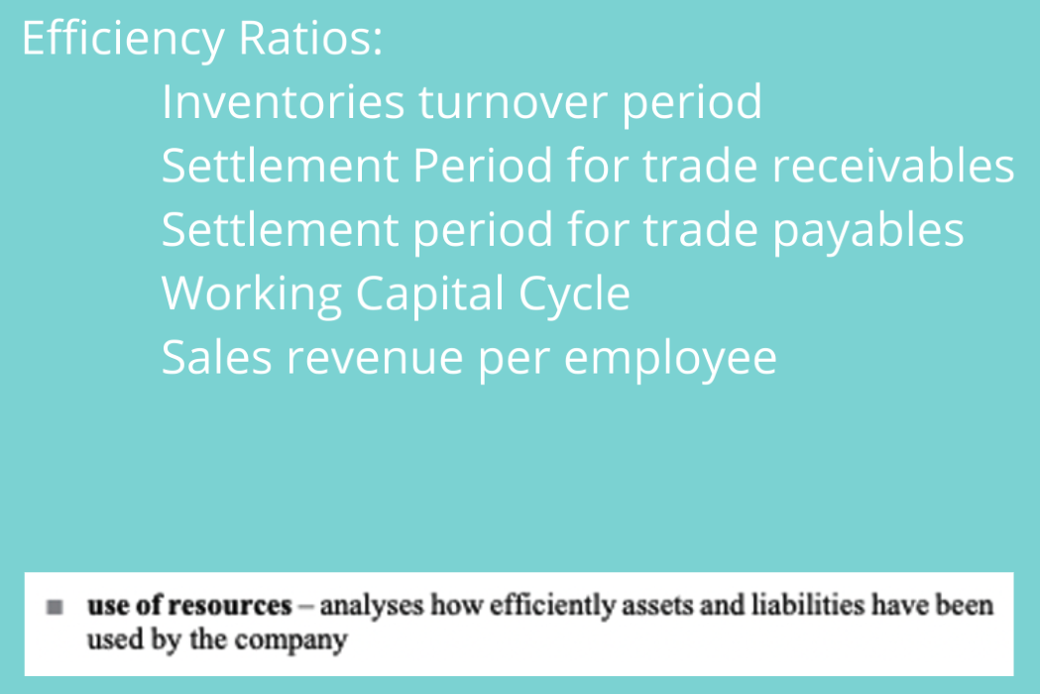

Slide 12
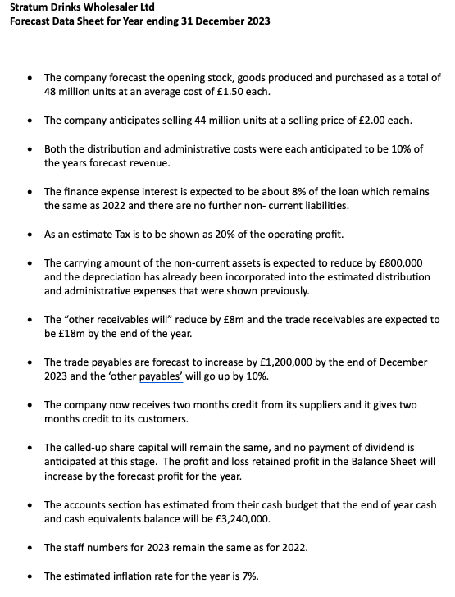
Phase 2-Complete forecast Accounts for 2023 from Data

Slide 13
Phase 3- Calculate Ratios for 2023

Slide 14
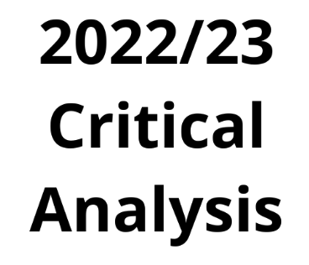

Slide 15
PHASE 4-CRITICALLY ANALYSE THE accounts FOR 2022 AND 2023
Profitability
Liquidity
Efficiency/Use of Resources
Gearing/Interest Cover

Slide 16
PHASE 5-Possible other factors to consider for 2022/3
Inflation (Estimated figure given in Data)
Cost of living
Other similar company/companies comparison
Actual state of the industry 2023
Actual state of the economy 2023

Slide 17
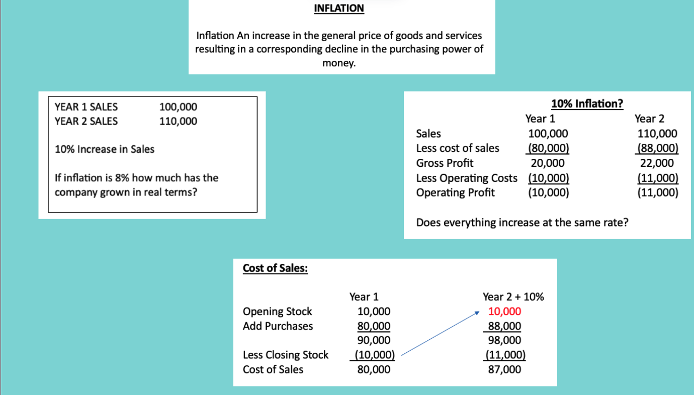

Slide 18
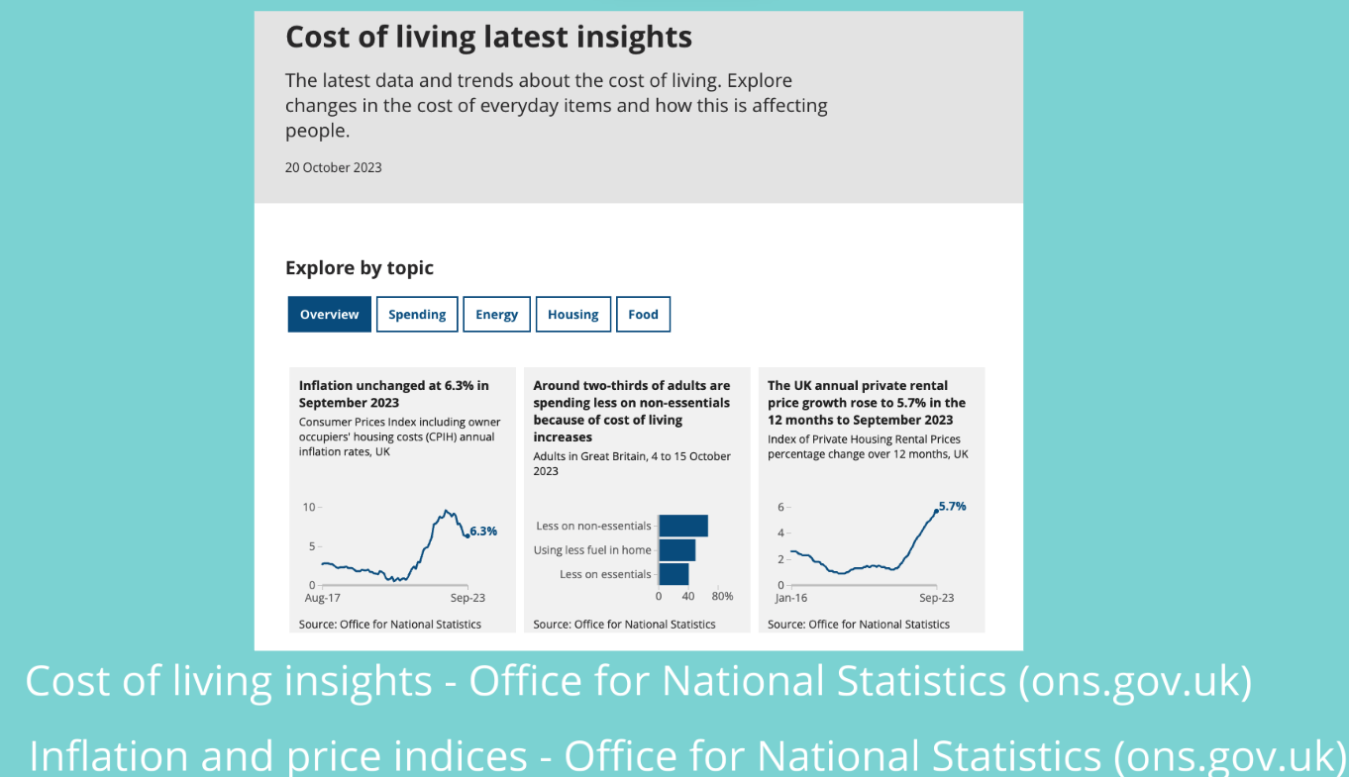

Slide 19
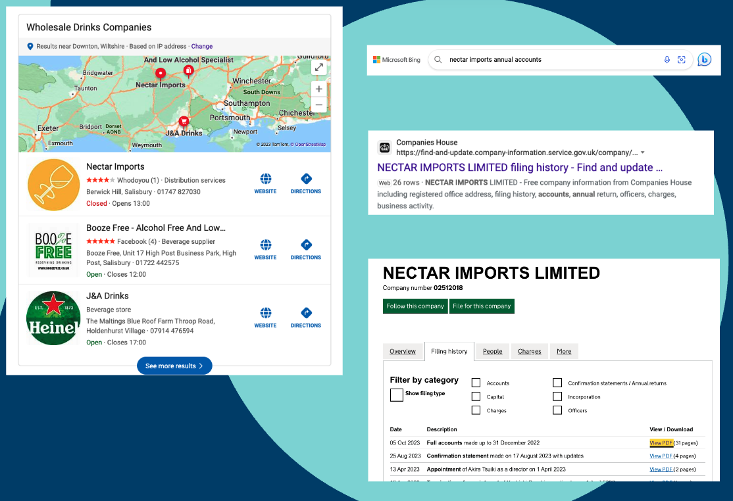
Similar Company

Slide 20
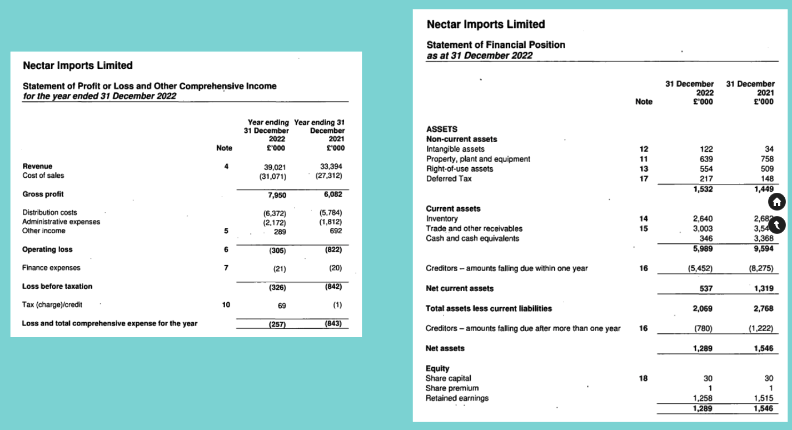

Slide 21
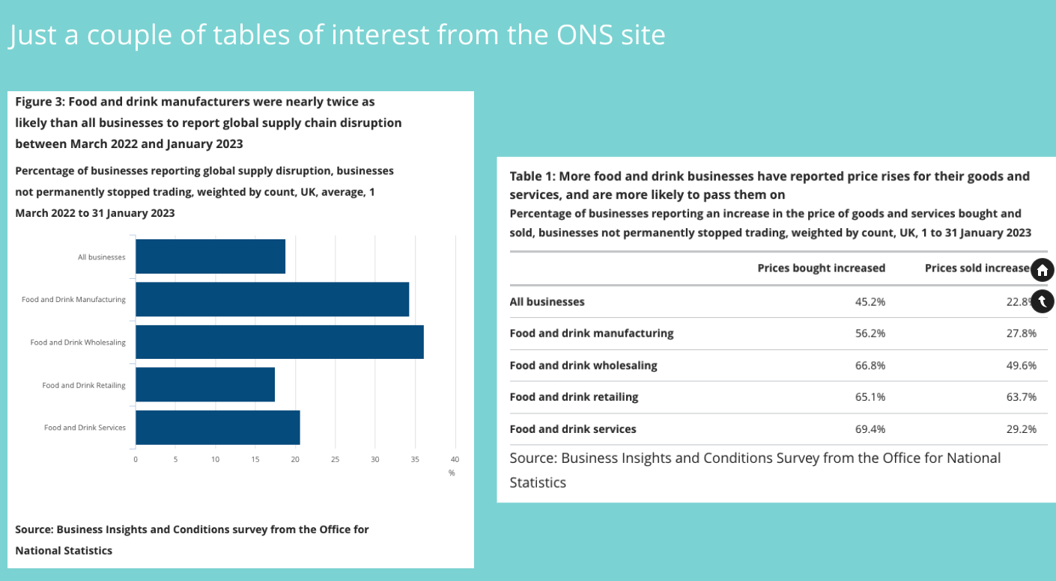
State of Industry/Economy

Slide 22
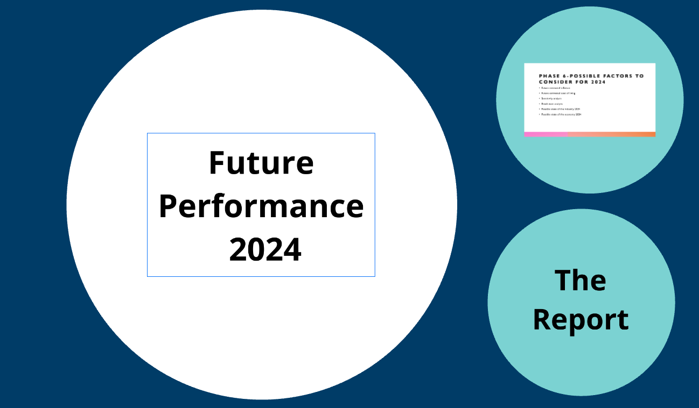

Slide 23
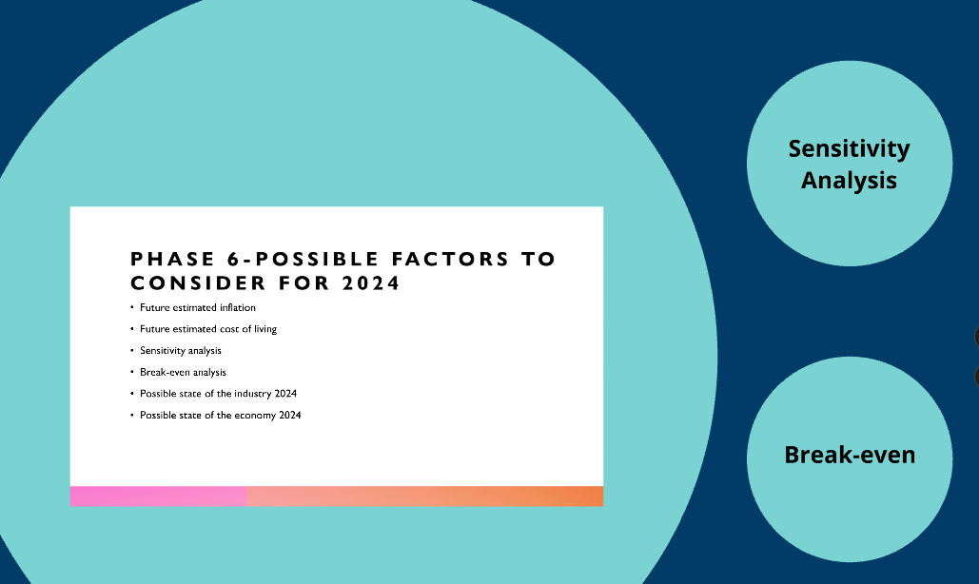

Slide 24
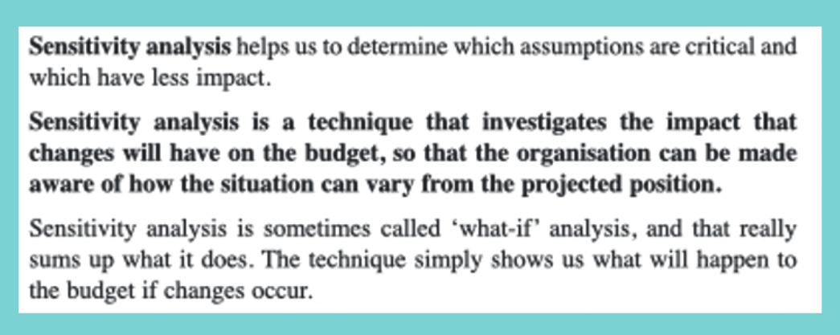

Slide 25
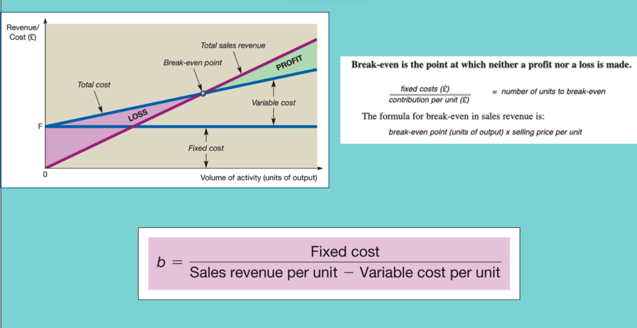

Slide 26


Slide 27
